Slide 1


TEAM TRITON
Presents
Crowd Analyser

Slide 2





OUR TEAM
AMAN VERMA
AYUSH KARAN
MEENAKSHI DEWANGAN

Slide 3

PROBLEM STATEMENT:
CROWD ANALYSER
As the vendors don’t have a proper track about popular foods ordered at a point of time in the day makes them unable to pre-prepare the food items required. Come up with a dashboard where they can manage this all.

Slide 4

The basic problems for the given problem statements is tackled by a Power BI Dashboard i.e. designed to help food vendors, prepare food items in advance based on the most popular and usual orders at that point of time in the day. Creating a Power BI dashboard to manage popular food orders throughout the day can provide vendors with valuable insights, improve operational efficiency, reduce costs, enhance customer satisfaction, and give them a competitive edge in the food service industry. It helps vendors overcome challenges related to data visibility, food preparation, inventory management, and decision-making.

Slide 5
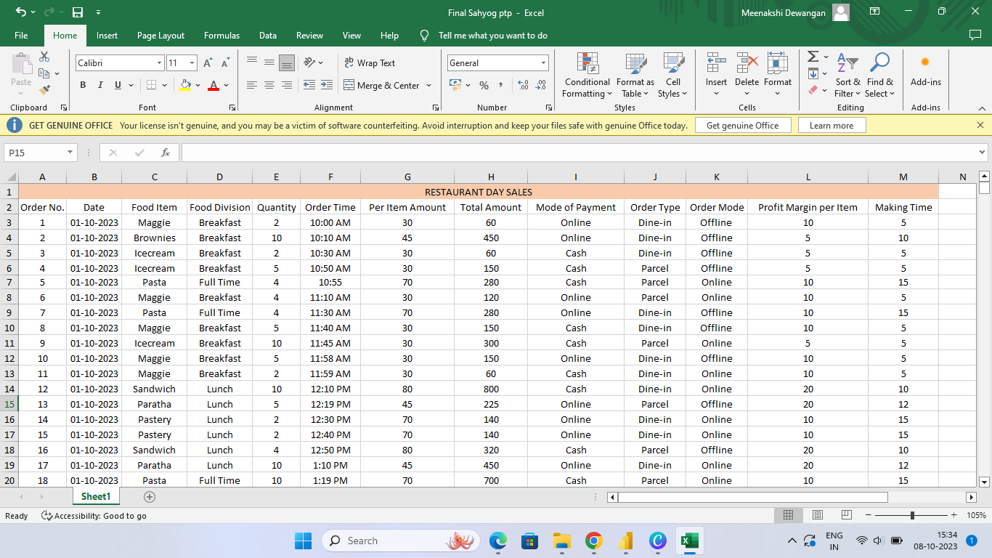
Excel Sheet

Slide 6

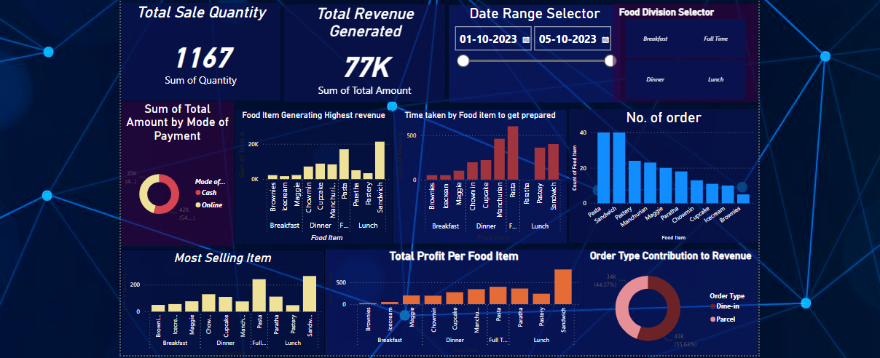
DASHBOARD

Slide 7
Dashboard Components
1. Date Range Selector:

Slide 8
Dashboard Components
2. Food Division Selector

Slide 9
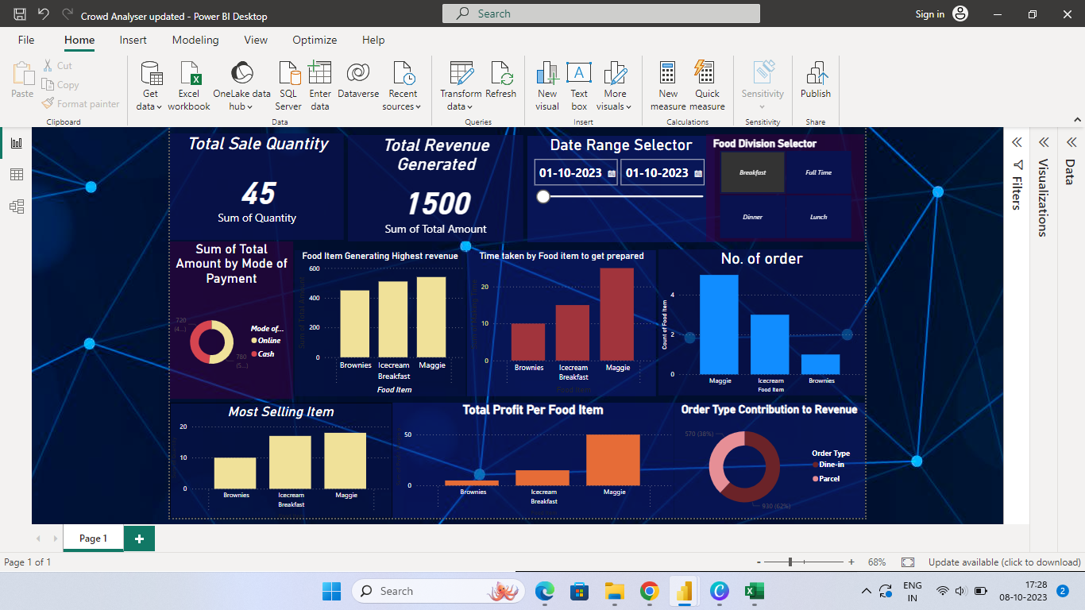
Dashboard Components
3. Most Selling Item:

Slide 10
Dashboard Components
4. Number of Order:

Slide 11
Dashboard Components
5. Food Item Generating Highest Revenue :

Slide 12
Dashboard Components
6. Total Profit Per Food Item:

Slide 13
Dashboard Components
7. Time taken by food
item to get prepared:

Slide 14
Dashboard Components
8. Order Type
Contribution to Revenue:

Slide 15
Dashboard Components
9. Sum of Total Amount by Mode of Payment:

Slide 16
Dashboard Components
10. Total Sales Count

Slide 17
Dashboard Components
11. Total Revenue
Generated:

Slide 18
Challenges solved with the help of Power BI DashBoard :-
Lack of Data Visibility: Vendors often struggle with limited visibility into their daily operations. The dashboard provides a centralized platform to view and analyze data, overcoming this challenge.
Inefficient Food Preparation: Without insights, vendors may over-prepare or under-prepare food items, leading to wastage or customer dissatisfaction. The dashboard helps vendors prepare food more efficiently.
Inventory Costs: Maintaining a large inventory can be costly. The dashboard helps vendors optimize their inventory levels, reducing costs associated with excess ingredients.
Waiting time: Vendor was often struggling with delivering the food item in proper time.This Problem has been solved using Power BI Dashboard.

Slide 19
Where to access dashboard ?
Dashboard can be accessed from following system :-
Windows
Mac
Android

Slide 20
Thank you
Team Triton

